Slide 1
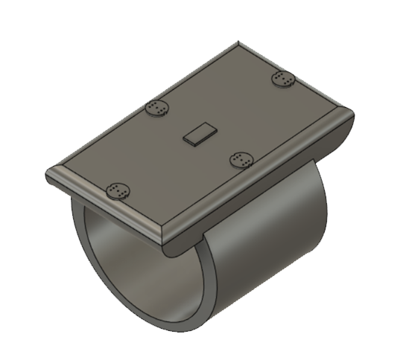
GLAID
AID FOR THE HEARING IMPAIRED
Aishwarya Omar- IIT Gandhinagar
Daksh Adhar – IIT Guwahati

Slide 2

HEARING LOSS
According to the World Health Organization, over 5% of the world population suffers from disabling hearing loss
By 2050 nearly 2.5 billion people are projected to have some degree of hearing loss

Slide 3

HEARING AIDS…BUT
Hearing Aid
Amplifies sounds
Not usable in all cases
NO SENSE OF DIRECTION
Source: United States National Library of Medicine

Slide 4
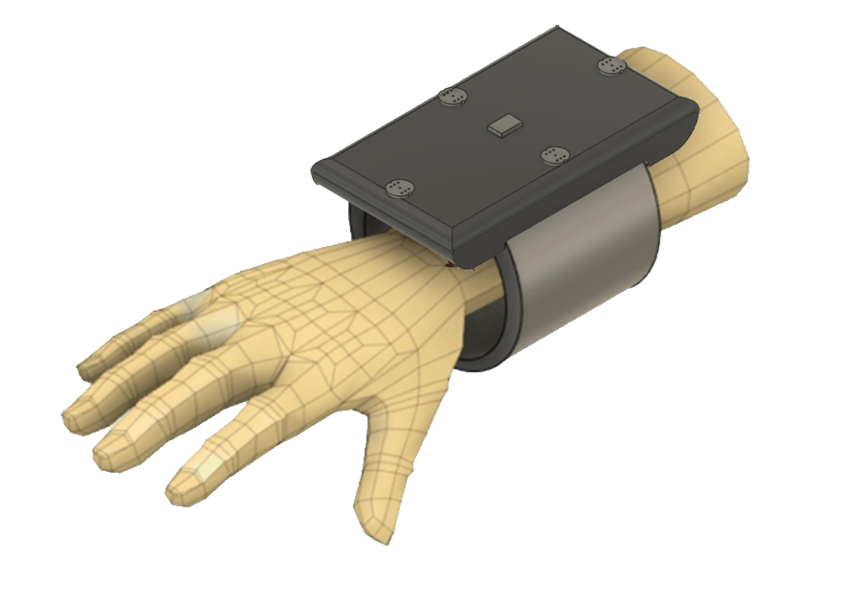
OUR INVENTION
OUR INVENTION
Wearable Device
Array of Microphones
Directionality of sound
Tactile feedback

Slide 5
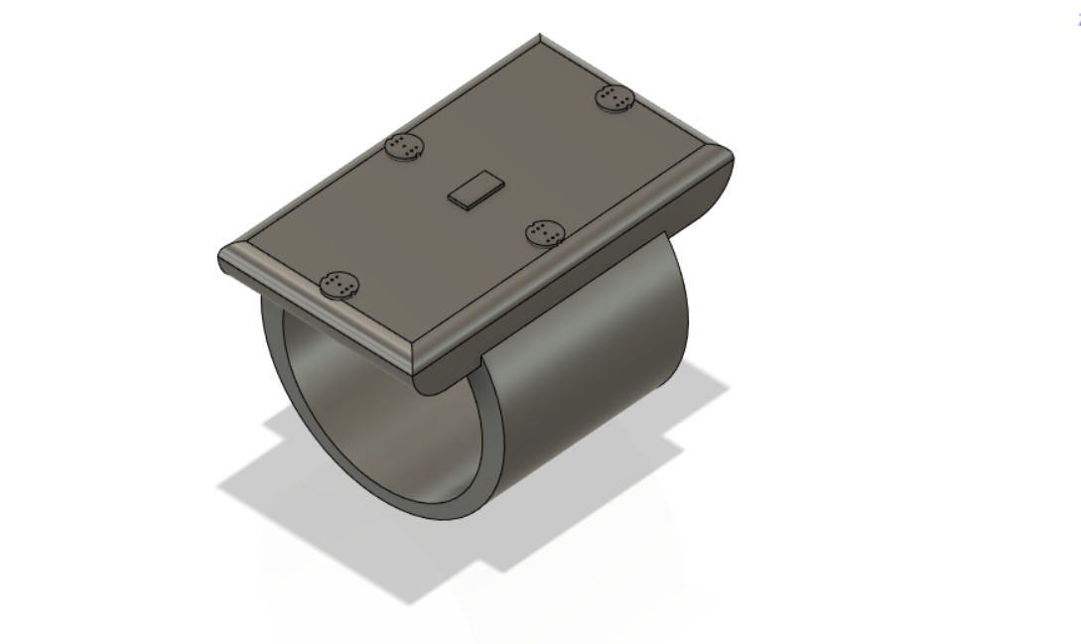
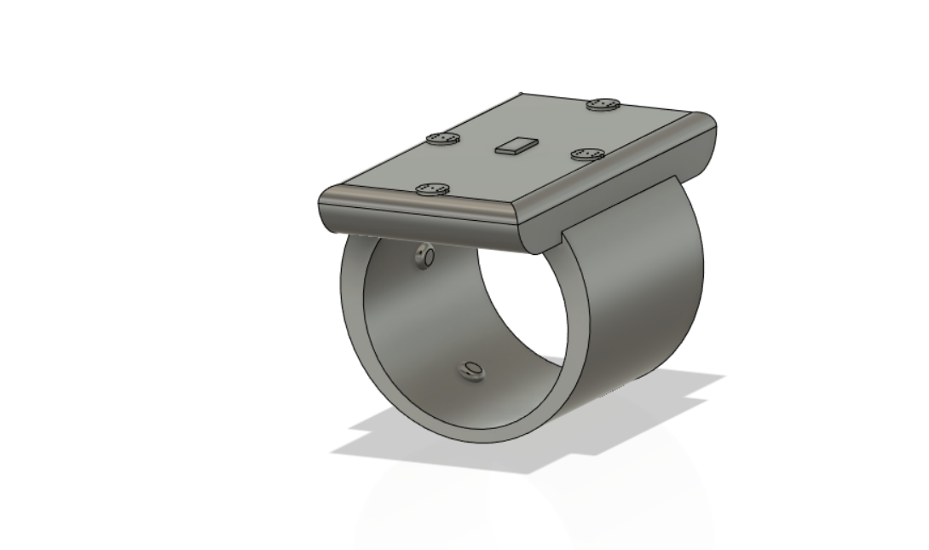
OUR INVENTION
MICROPHONE
IMU SENSOR
MICROCONTROLLER
(custom ML algorithm)
VIBRATING MOTORS

Slide 6
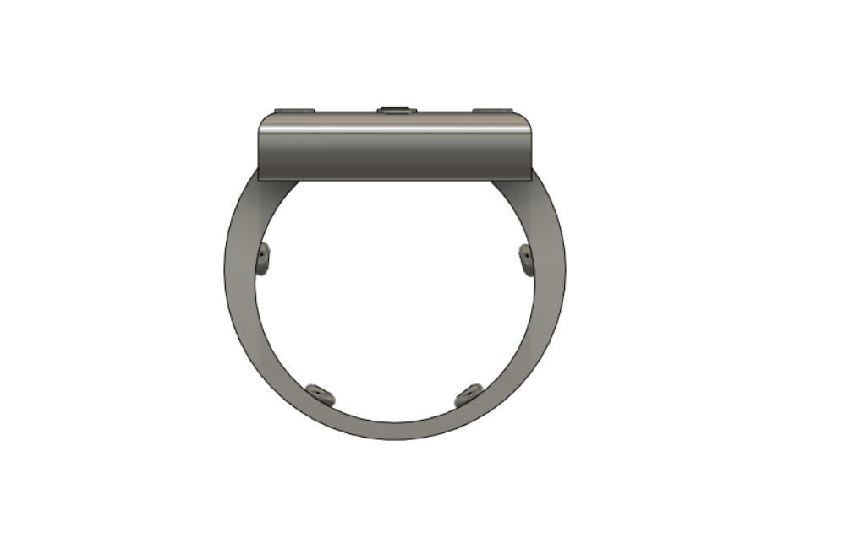
HOW?
animation
Front
Front
Back
Back

Slide 7
HOW?
Left
Right
Left
Right

Slide 8
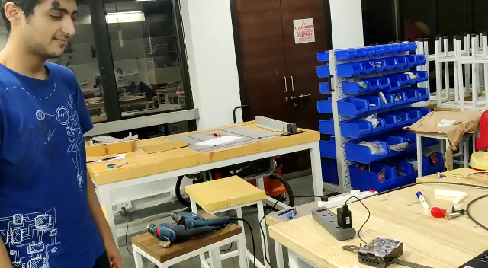
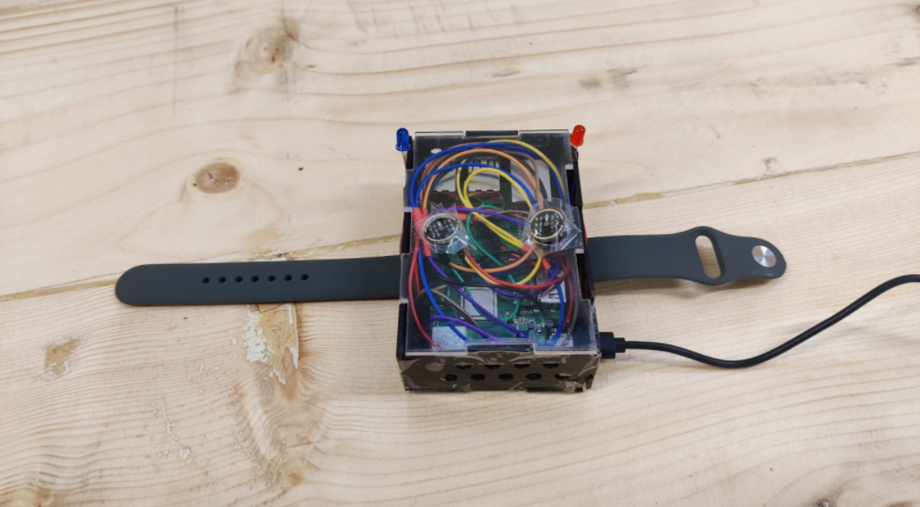
Better picture
DEMONSTRATION
LED Glowing

Slide 9
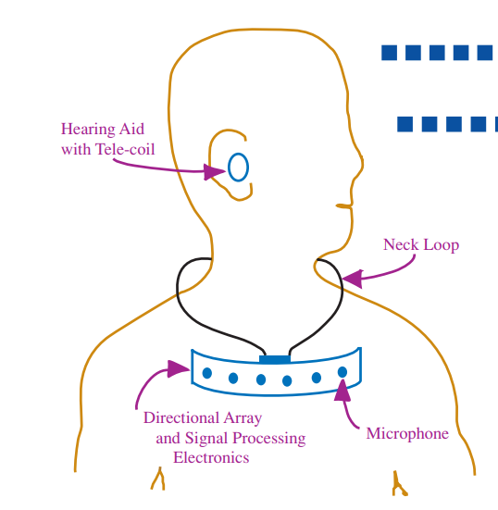
PRIOR ART
NECKLACE ARRAY
Not compatible with all hearing aids
Amplifies all sounds
Classification: (A61F11/045)

Slide 10
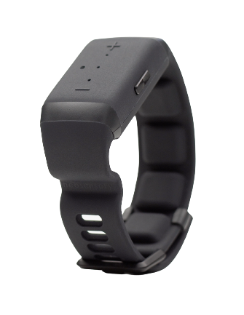
PRIOR ART
MIX BOTH 10/11 slides
BUZZ
Uses Frequency Modulation
Requires excessive training
NO SENSE OF DIRECTION
Classification: (A61F11/045)

Slide 11
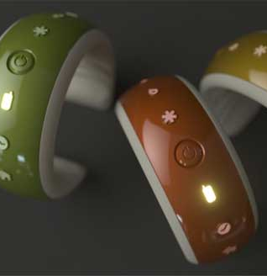
PRIOR ART
ARIA
Visual Patterns
Limited to alerts
NO SENSE OF DIRECTION
Classification: (A61F11/045)

Slide 12
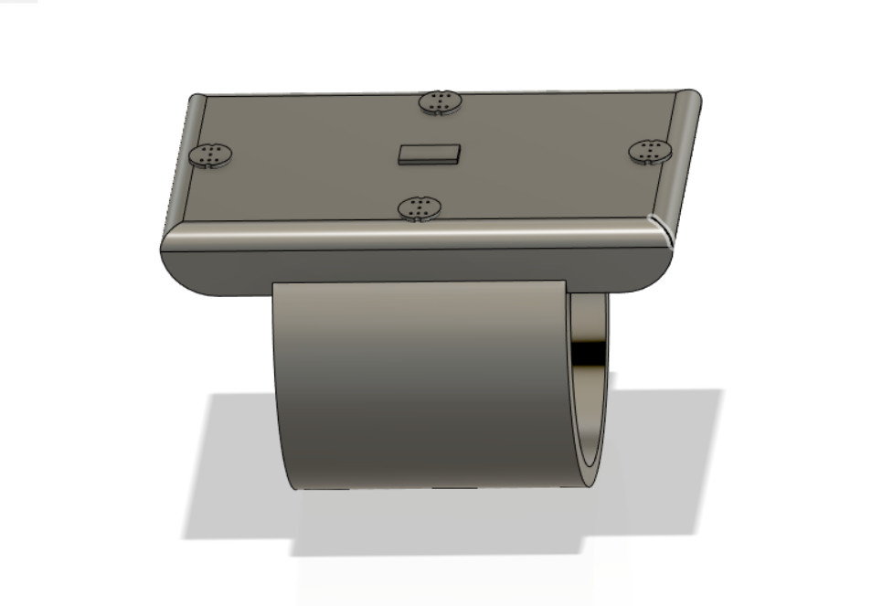
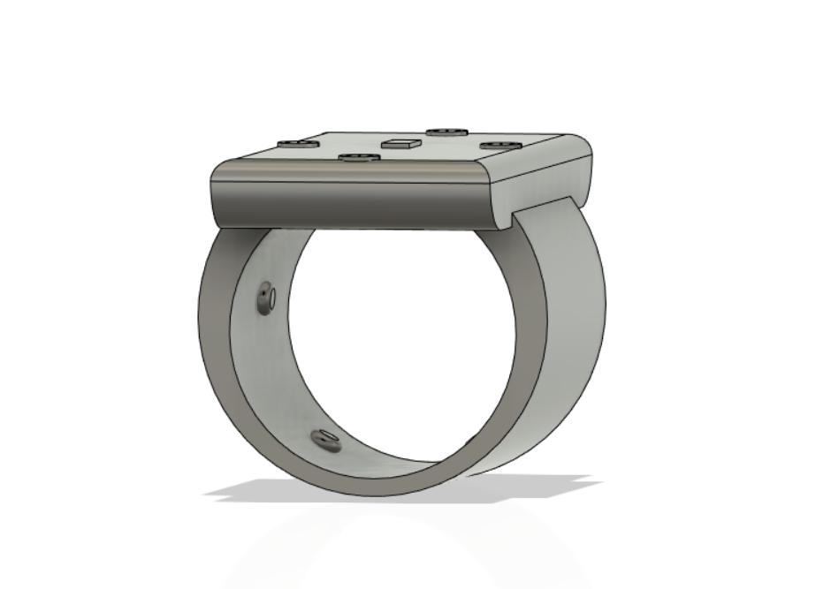
SUMMARY
OUR INVENTION
REAL PHOTO

